Slide 1
Welcoming college blog
Web-D Group

Slide 2
AGENDA
PROBLEM STATEMENT
PROJECT OVERVIEW
WHO ARE THE END USERS?
YOUR SOLUTION AND ITS VALUE PROPOSITION
THE WOW IN YOUR SOLUTION
MODELLING
RESULTS
MEET OUR TEAM

Slide 3
PROBLEM STATEMENT
Hello we are students of ADIT NSTI Noida, when we wanted to take admission in NSTI Noida then our parents had many questions in their mind like how will be our college, how will be our class, we were curious to know everything about the college which that we could not find easily.
we wanted to know about our course & admission fees.
Hostel and college facility

Slide 4
SOLUTION AND ITS VALUE PROPOSITION
Full information of our college in this website.
Complete information about the courses running in our college is given.
Pictures of the classrooms and labs of each trade in our college are given.
Photos of every event of the college are given in the gallery of the website.
Full address with map, and contact form provided.

Slide 5
THE WOW IN YOUR SOLUTION
Entry form
Contact form
Picture of all events and class rooms
Easy to access
Beautifull Look
Fully responsive
Official website link of DGT in the logo

Slide 6
WHO ARE THE END USERS?
Future Students
Present students
Parents/Guardian

Slide 7
PROJECT OVERVIEW
This is our final project of core Module-3. By using different technology like :- HTML, CSS, BOOTSTRAP, JAVASCRIPT, JQUERY, PHP, MySQL We have put all information about our college on this website. Through this website you all can visit or know more information about NSTI Noida College.

Slide 8
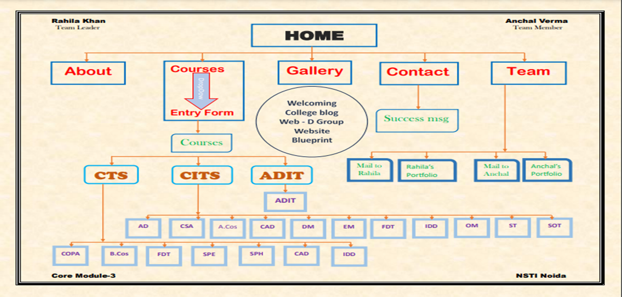
MODELLING
Index Page

Slide 9
RESULTS
Students will be able to easily get the information of the college from only one platform.
they will not need to take information from YouTube or any other medium.
Students will be able to get their queries solved by contacting us directly.

Slide 10

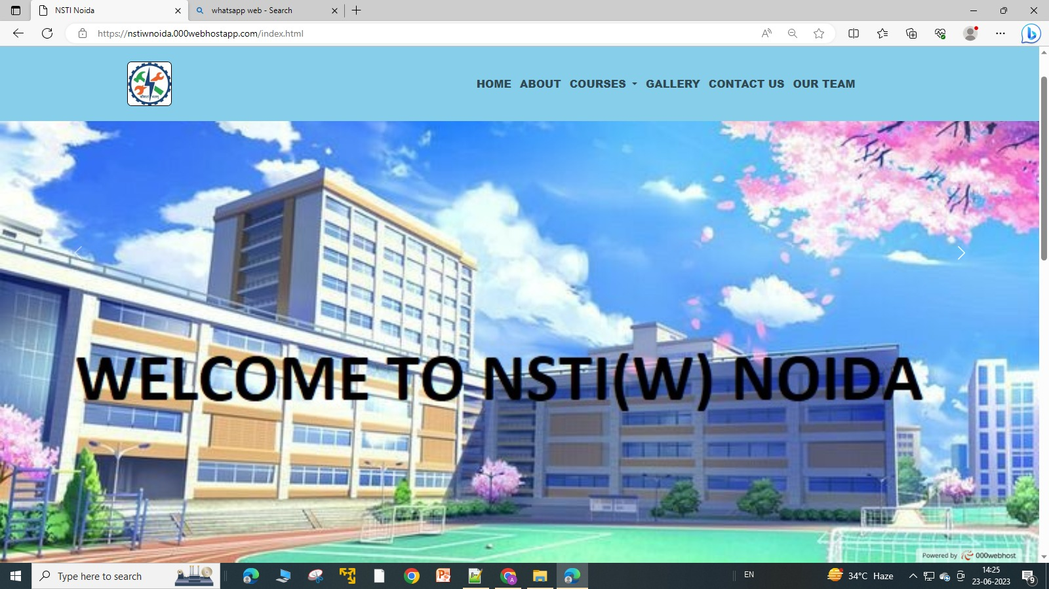
Home Page

Slide 11
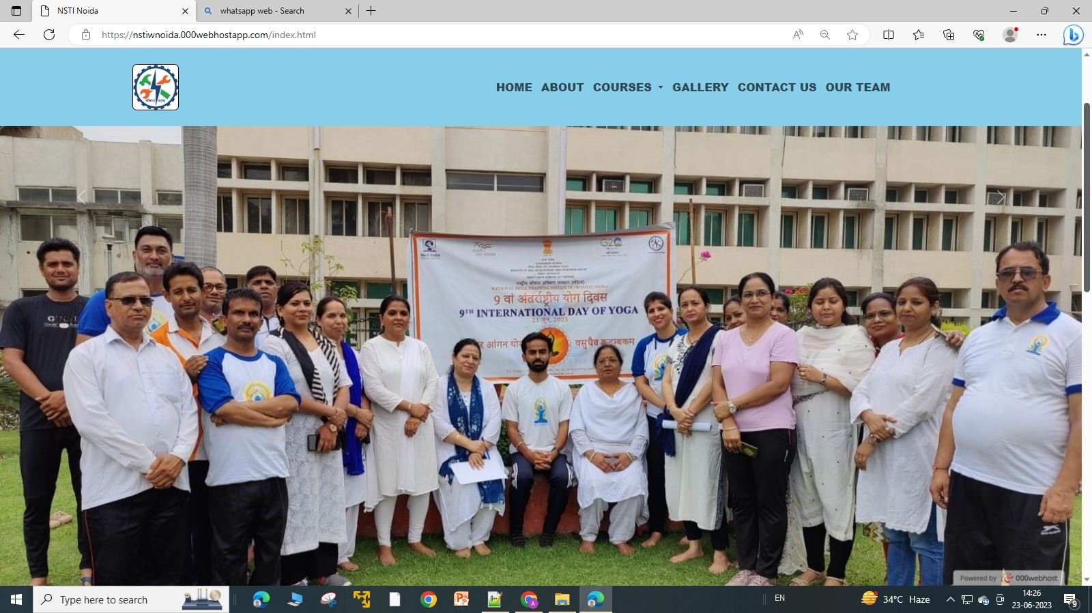
Index Second page

Slide 12
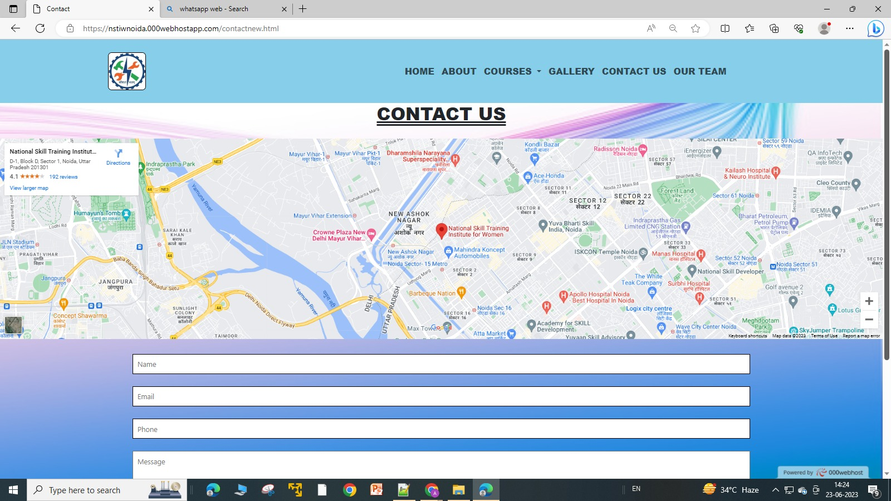
Contact Page

Slide 13
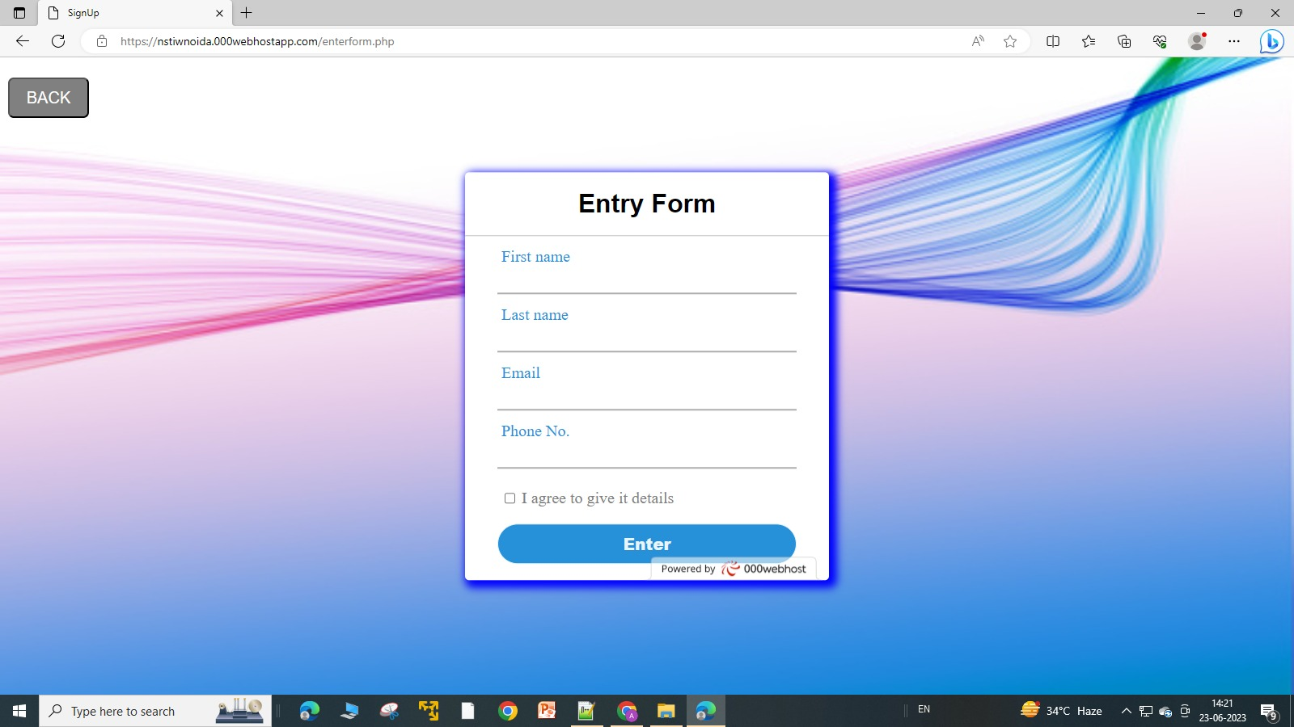
Entry Form

Slide 14
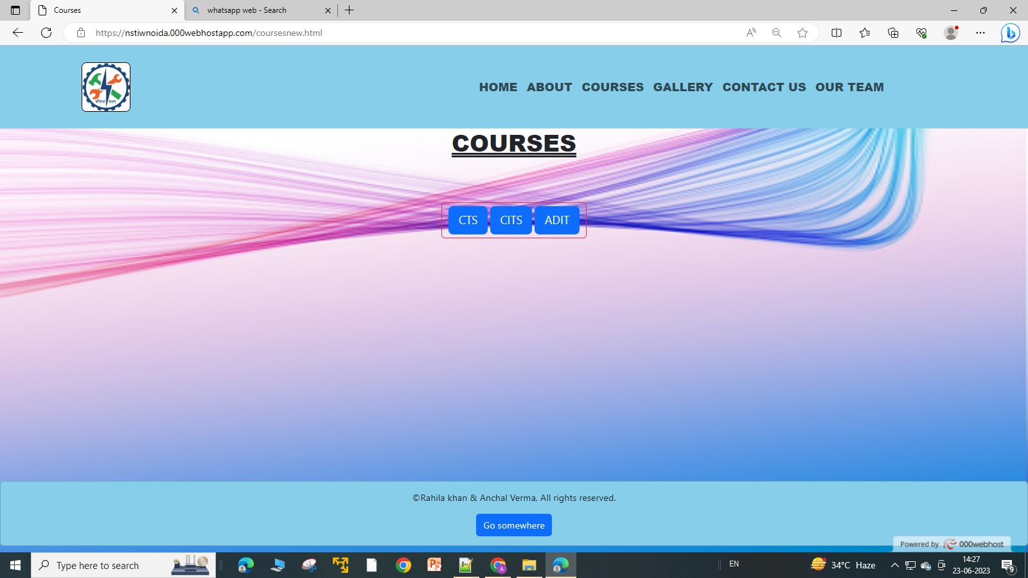
After entry Courses page

Slide 15
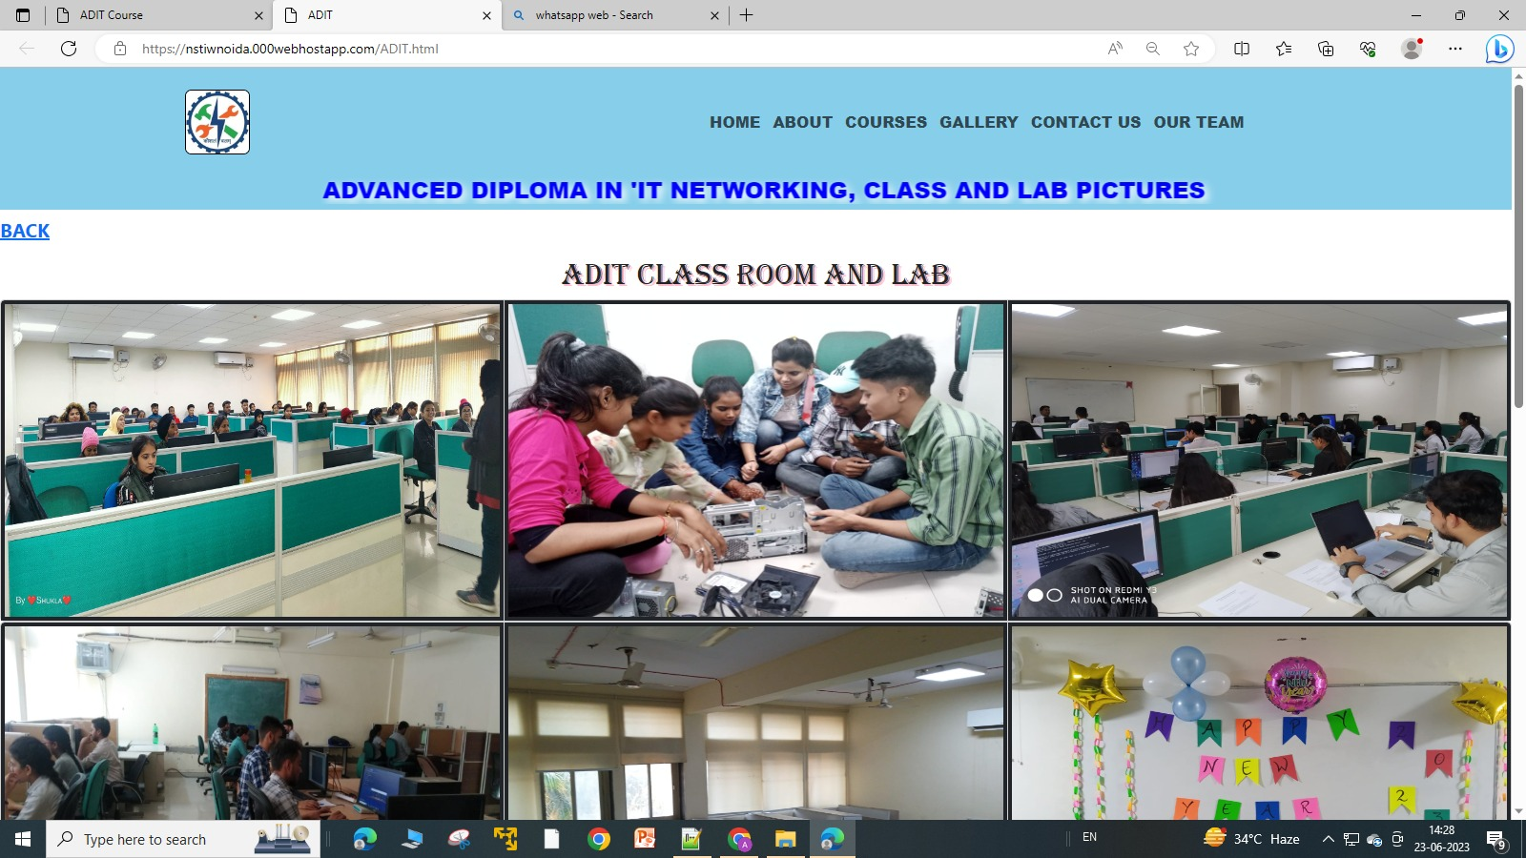
Trade page OR Sub page

Slide 16
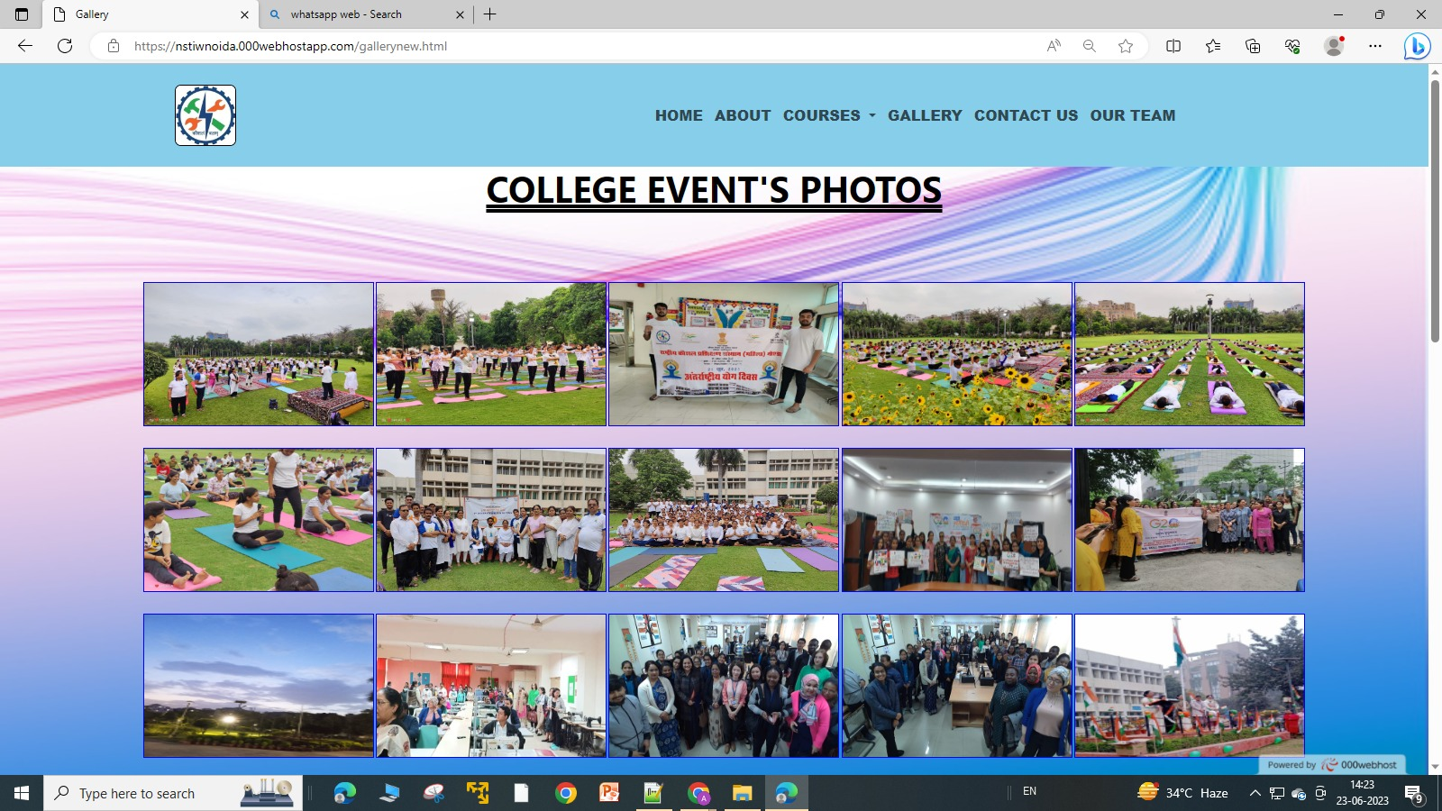
Gallery Page

Slide 17
Gallery Page

Slide 18
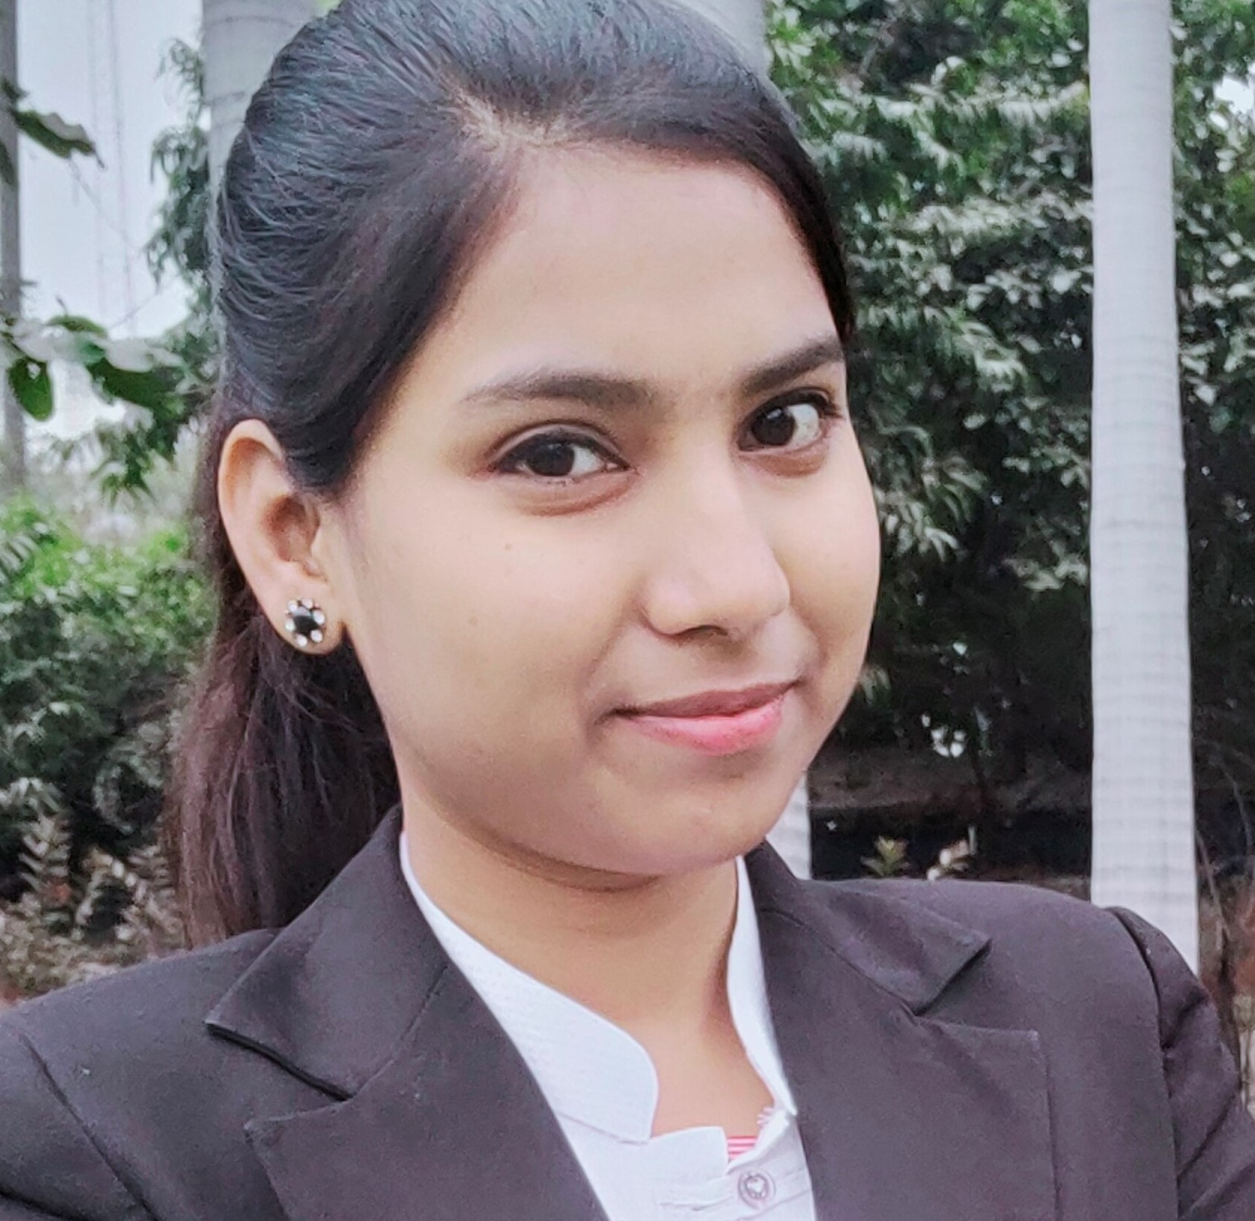
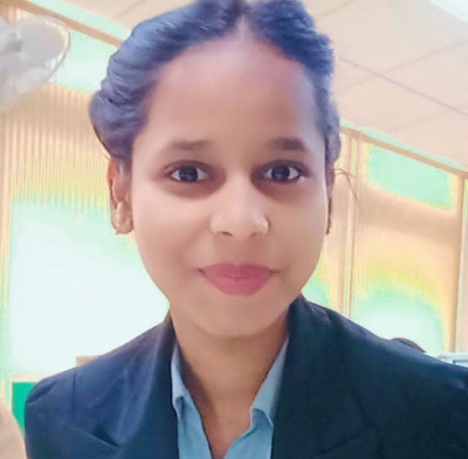
MEET OUR TEAM
Anchal Verma
(Team Member)
Highest Qualification
CITS From CSA Trade
Rahila khan
(Team Leader)
Highest Qualification
ITI From COPA Trade

